Slide 1
Problems on Trains

Slide 2
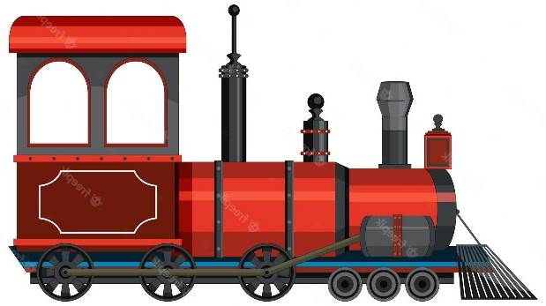
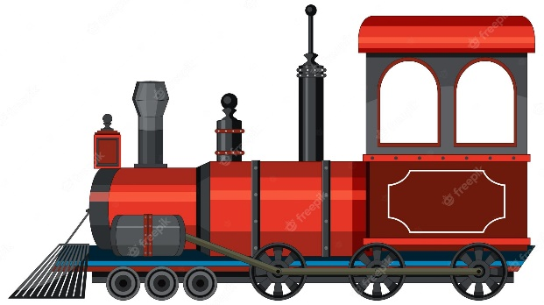
RELATIVE SPEED
S₁ S₂
RELATIVE SPEED
S_{R} = S₁ + S₂
(CROSSING)
S₁
S₁
RELATIVE SPEED
S_{R} = S₁ – S₂
S₂

Slide 3


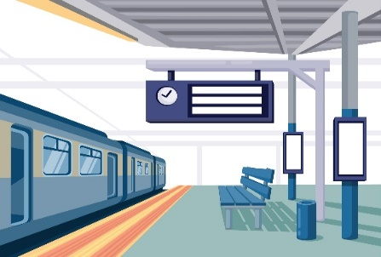
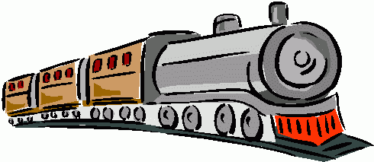



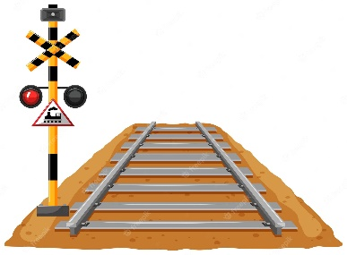
Point Object and Length Object
Length object:
Train Tunnel Bridge Platform
Point object:
Traffic signal Man Electric Pole Car

Slide 4
TRAIN PROBLEMS
Train problems broadly centre around the following three types.
L_{t}= Length of the train
S = Speed of the train
T = Time taken
1. Length object crossing the point object
Distance Travelled = Length of the train
Time taken(T) = L_{t} / S
2. Length object crossing the length object
Distance Travelled = Length of train + length of object
Time Taken = (L_{t} + SL )/ S
3. Length object crossing movable length object
Distance Travelled = Length of train + length of object Speed by which trains are moving = Relative Speed(S_{R})
Time Taken = (L_{t1} + L_{t2} )/S_{R}

Slide 5
A train passes a station platform in 36 seconds and a man standing on the platform in 20 seconds. If the speed of the train is 54 km/hr, then what is the length of the platform?
200 m
240 m
300 m
864 m
Ans: B

Slide 6
Two trains are running In opposite direction with the same speed. If the length of each train is 135 meters and they cross each other in 18 seconds, the speed of each train is
29 km/hr
35 km/hr
27 km/hr
54 km/hr
Ans: C

Slide 7
A policeman starts chasing a thief who is 250 metres ahead of the policeman. If the policeman was able to catch the thief in 15 minutes and the speed of the thief is 8 km/h, find the distance travelled (in kilometres) by the policeman in 15 minutes.
1.5 km
2 km
2.25 km
2.5 km
Ans: C

Slide 8
Two men start travelling in the opposite direction up to a point where the other started. If they take 13 minutes and 52 minutes respectively to reach the other end, after how much time (all in minutes) would they have met?
39
10.4
26
Cannot say
Ans: B

Slide 9
A train travelling at 42 km/h passes a runner in 9 seconds running in same direction and took 5 seconds in the opposite direction. Find the length of the train.
75 m
100 m
84 m
90 m
Ans: A

Slide 10
A man standing on a railway platform notices that a train going in one direction takes 10 seconds to pass him and other train of the same length takes 15 seconds to pass him. Find the time taken by the two trains to cross each other when they are running in the opposite direction (all in seconds).
12
14
13.5
15
Ans:A

Slide 11
Two guns were fired from the same place at an interval of 13 minutes but a person in a train approaching the place hears the second report 12 minutes 30 seconds after the first. Find the speed of the train in m/s, supposing that sound travels 330 metres per second?
12 m/s
13 m/s
14 m/s
13.2 m/s
Ans: D

Slide 12
A car travelling in fog passed a man walking at 3 km/h in the same direction. He could see the car for 4 minutes and up to a distance of 100 m. What is the speed of the car (all in km/h)?
40.5
4.5
1.5
5.5
Ans: B

Slide 13
A car travelled a distance of 600 km in 6 hours. The first part of the journey is covered with a speed of 70 km/h and the rest of the journey is covered with the speed of 120 km/h. The distance covered in the first part of the journey is
240 km
120 km
168 km
None of these
Ans: C

Slide 14
Two trains of length 115 m and 110 m respectively run on parallel rails. When running in the same direction, the faster train passes the slower one in 25 seconds, but when they are running in opposite directions with the same speeds as earlier, they pass each other in 5 seconds. Find the speed of the faster train.
27 m/s
18 m/s
36 m/s
None of these
Ans: A

Slide 15
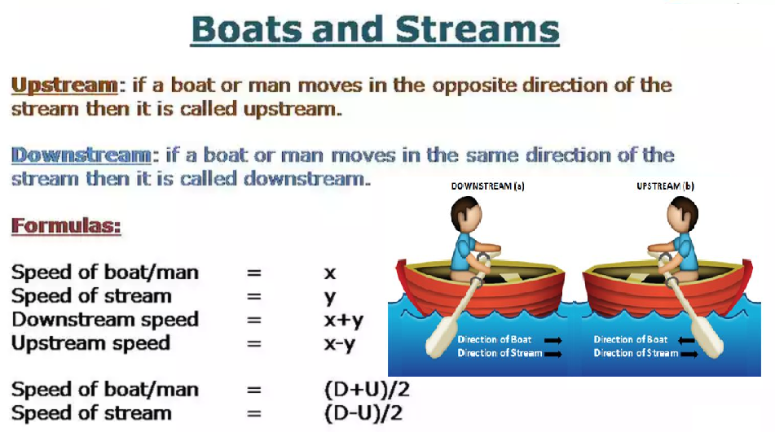

Slide 16
Type 1: When the distance covered by the boat in downstream is the same as the distance covered by the boat upstream. The speed of the boat in still water is x and the speed of the stream is y then the ratio of time taken in going upstream and downstream is,
Short Trick:
Time taken in upstream : Time taken in Downstream = (x+y)/(x-y)
Example: A man can row 9km/h in still water. It takes him twice as long as to row up as to row down. Find the rate of the stream of the river.
Solution:
Time taken in upstream: Time taken in Downstream = 2:1
Downstream speed : Upstream speed = 2:1
Let the speed of man = B, & speed of stream = S
B + S : B – S = 2/1
By using Componendo & Dividendo
B/R = 3/1, R = B/3
R = 9/3 = 3km/h

Slide 17
A man can row 4km/h in still water and he finds that it takes him twice as long to row up as to row down the river. Find the rate of stream?
2.33kmph
5.33kmph
7.33kmph
1.33kmph

Slide 18
Type 2: A boat covers a certain distance downstream in t1 hours and returns the same distance upstream in t2 hours. If the speed of the stream is y km/h, then the speed of the boat in still water is:
Short Trick: Speed of Boat = y [(t2 + t1) / (t2 – t1)]
Example
A man can row a certain distance downstream in 2 hours and returns the same distance upstream in 6 hours. If the speed of the stream is 1.5 km/h, then the speed of man in still water is
Solution:
By using the above formulae
= 1.5 [(6+2) / (6-2)] = 1.5 * (8/4) = 1.5 * 2 = 3km/h

Slide 19
A man can row certain distance downstream in 6 hours and return the same distance in 8 hours. If the stream flows at the rate of 4 km/h, then find the speed of the man in still water.
1. 20 km/h
2. 28 km/h
3. 32 km/h
4. 48 km/h

Slide 20
Type 3: A boat’s speed in still water at x km/h. In a stream flowing at y km/h, if it takes it t hours to row to a place and come back, then the distance between two places is
Short Trick: Distance = [t*(x² – y²)]/2x
Example
A motorboat can move at a speed of 7 km/h. If the river is flowing at 3 km/h, it takes him 14 hours for a round trip. Find the distance between two places.
Solution: By using the above formulae
= [14 * (7² – 3²)]/2* 7 = [14 * (49-9)]/2*7
= 14*40/2*7 = 40km

Slide 21
A motor boat covers the distance between two places on a river and returns in 14 hrs. If the velocity of the boat in still water is 35 km/h and velocity of water in the river is 5 km/h, then the distance between the two places is
100km
240km
220km
110km

Slide 22
Type 4: A boat’s speed in still water at x km/h. In a stream flowing at y km/h, if it takes t hours more in upstream than to go downstream for the same distance, then the distance is
Short Trick: Distance = [t*(x² – y²)]/2y
Example: A professional swimmer challenged himself to cross a small river and back. His speed in the swimming pool is 3km/h. He calculated the speed of the river that day was 1km/h. If it took him 15 mins more to cover the distance upstream than downstream, then find the width of the river.
Solution: By using the above formulae
Distance = [t*(x² – y²)]/2y
= [(15/60) (3² – 1²)]/2*1
= [(1/4) * 8] / 2
= 2/2 = 1 km.

Slide 23
A man rows to a place and back in 8hrs. Speed of a man is 4kmph and that of current is 1kmph. Find the distance travelled by a man.
15km
20km
25km
None of these

Slide 24
Type 5: A boat’s speed in still water at x km/h. In a stream flowing at y km/h, if it covers the same distance up and down the stream, then its average speed is
Short Trick: Average speed = upstream * downstream / man’s speed in still water
Note: The average speed is independent of the distance between the places.
Example: Find the average speed of a boat in a round trip between two places 18 km apart. If the speed of the boat in still water is 9km/h and the speed of the river is 3km/h?
Solution: Average speed = upstream * downstream / man’s speed in still water
Average speed = 6 * 12 / 9 = 8km/h

Slide 25
Find the average speed of a boat in a round trip between two places 25 km apart. If the speed of the boat in still water is 10km/h and the speed of the river is 5km/h?
7.5
8.25
9.5
None of these

Slide 26
A person can swim in water with a speed of 13 km/hr in still water. If the speed of the stream is 4 km/hr, what will be the time taken by the person to go 68 km downstream?
2.5 hours
3 hours
4 hours
3.5 hours
4.5 hours

Slide 27
A boat can travel with a speed of 13 km/hr in still water. If the speed of the stream is 4 km/hr, find the time taken by the boat to go 68 km downstream.
2 hours
3 hours
4 hours
5 hours

Slide 28
A motorboat, whose speed in 15 km/hr in still water goes 30 km downstream and comes back in a total of 4 hours 30 minutes. The speed of the stream (in km/hr) is:
4
5
6
10

Slide 29
A boat running downstream covers a distance of 16 km in 2 hours while for covering the same distance upstream, it takes 4 hours. What is the speed of the boat in still water?
4 km/hr
6 km/hr
8 km/hr
Data inadequate

Slide 30
A boat takes 90 minutes less to travel 36 miles downstream than to travel the same distance upstream. If the speed of the boat in still water is 10 mph, the speed of the stream is:
2 mph
2.5 mph
3 mph
4 mph

Slide 31
A speedboat, whose speed in 15 km/hr in still water goes 30 km downstream and comes back in a total of 4 hours 30 minutes. What is the speed of the stream in km/hr?
2.5 km/hr
3.5 km/hr
4 km/hr
5 km/hr
3.25 km/hr

Slide 32
A boat is moving 2 km against the current of the stream in 1 hour and moves 1 km in the direction of the current in 10 minutes. How long will it take the boat to go 5 km in stationary water?
1 hr 20 minutes
1 hr 30 minutes
1 hr 15 minutes
30 minutes
45 minutes

Slide 33
The ratio of speeds of a motor boat to that of the current of water is 36:5. The motor boat goes along with the current in 5h 10 min. Find the time to come back of motor boat?
7hrs and 50 min.
7hrs and 30 min.
5hrs and 50 min.
5hrs and 30 min.
6hrs and 50 min.

Slide 34
A boat travels at a distance of 84 km upstream in 7 hours. If the ratio of the speed of boat in downstream is 25% more than the speed of boat in still water, then what is the distance covered by the boat along with stream in 6 hours?
A] 120 Km
B] 150 Km
C] 180 Km
D] 210 Km

Slide 35
The ratio of the speed of the boat in downstream to upstream is 7: 4. A boy takes 4 hours to cover the total distance of 88km upstream. What is the speed of the boat in still water?
A] 30.25 Kmph
B] 35 Kmph
C] 20.15 Kmph
D] 15 Kmph

